Slide 1
State of "The Cloud"
1.1

Slide 2
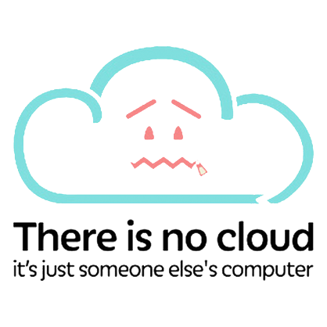
What is "The Cloud"?

Slide 3
Our Definition of "The Cloud"
"Cloud computing is the on-demand delivery of compute power, database, storage, applications, and other IT resources via the internet with pay-as-you-go pricing."

Slide 4
NIST's Definition of "The Cloud"
"Cloud computing is a model for enabling ubiquitous, convenient, on-demand network access to a shared pool of configurable computing resources (e.g., networks, servers, storage, applications, and services) that can be rapidly provisioned and released with minimal management effort or service provider interaction."

Slide 5

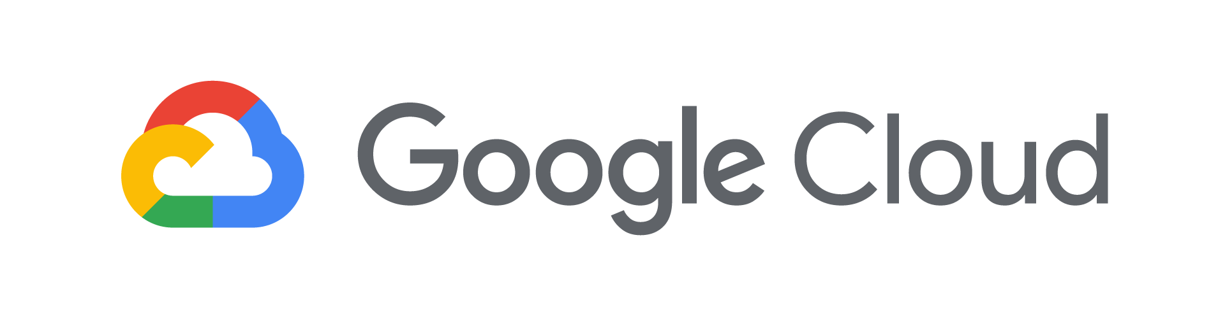
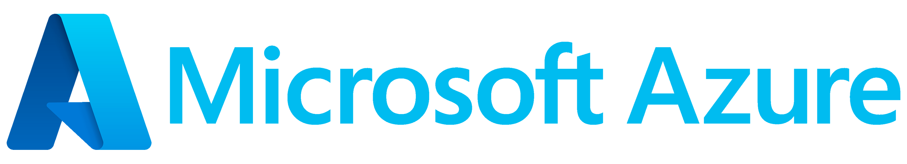
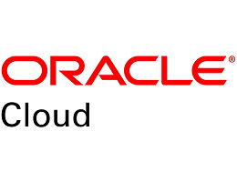
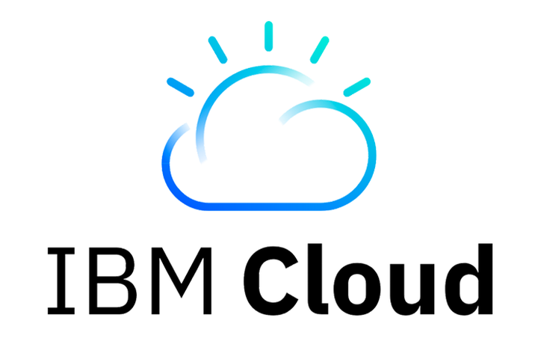

Who is "The Cloud"?

Slide 6
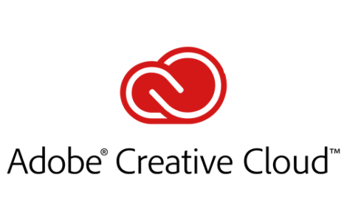
Who is "The Cloud"?

Slide 7
Why "The Cloud"?

Slide 8
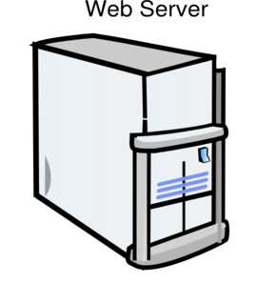
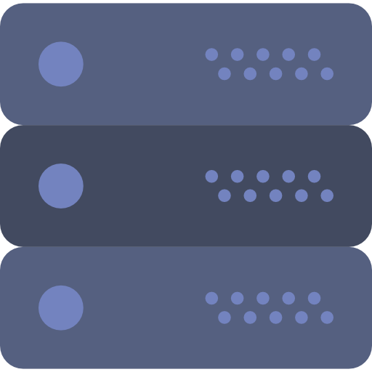

History Lesson!
1990s
2000s
2010s

Slide 9



Slide 12


Slide 14


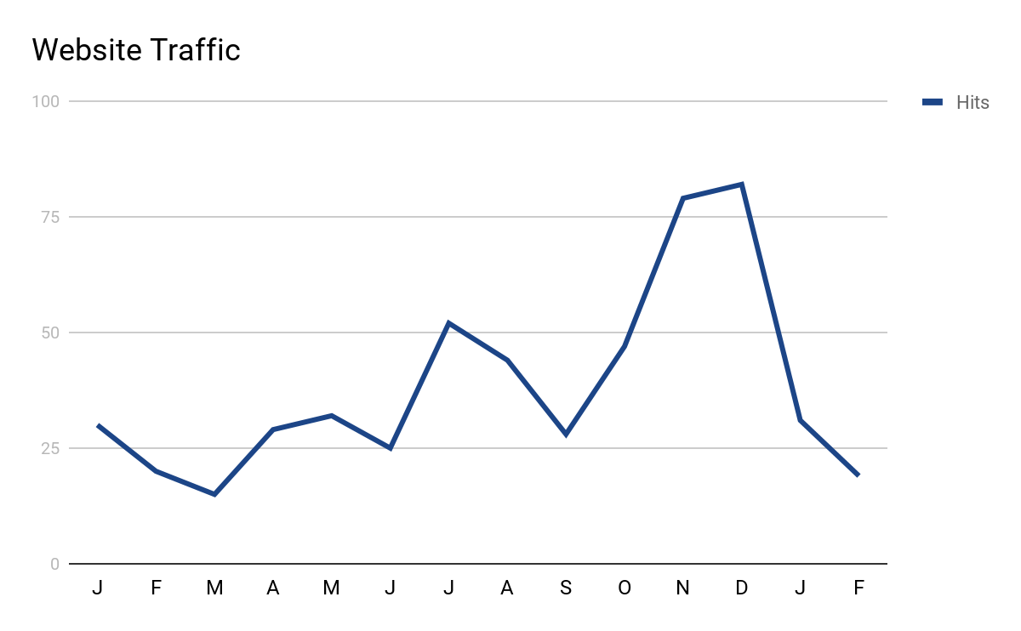

Slide 15


Slide 16



Slide 17




Alexa...

Slide 18
"____ as a service"

Slide 19
Domains of Cloud Computing
Machine Learning & AI
Networking & Hybrid Clouds
Data
Computing
Storage
Microservices / Cloud Functions
Virtual Machines
Application Hosting
Containers
Blob storage
Redundant and localized storage
Container orchestration
Data storage
Data analytics
Data ingestion & pipelines

Slide 20

Three GENERAL Tiers of Cloud Services
IaaS
(infrastructure as a service)
PaaS
(platform as a service)
SaaS
(software as a service)
More control over IT resources
Less control over IT resources

Slide 21
Software as a Service
What It Is: Software that allows users to "do" something - store, send, backup, connect, research
Target Market: End Users; non-technical
Examples: Gmail, iCloud Drive, Google Photos, Outlook.com, Salesforce, Instagram, OneDrive
"Key" Features: (these are not rules)
Generally, nothing to install
Users are not in control of versions or upgrades
Pay per level of use (even if it is free, you are just paying $0)
Not tied to a specific machine or device

Slide 22
Platform as a Service
What It Is: A tool or set of tools that allow users to "build" something
Target Market: Developers / Creators
Examples: Google App Engine, Heroku, Azure App Service, AWS Elastic Beanstalk, hosted SQL Server instance, MongoDB Atlas
"Key" Features: (these are not rules)
Some installation is possible (maybe a software development kit)
Applications with high memory or graphics needs
Users may choose from specific versions to use for compatibility
Pay per level of use (even if it is free, you are just paying $0)
Still don't have to think about underlying hardware; might have automatic scaling (elasticity)

Slide 23
Infrastructure as a Service
What It Is: A hosted solution with specific features and capabilities as defined by the user ("A virtual machine in the cloud.")
Target Market: Networking Engineers, Software Engineers, SuperNerds
Examples: Azure Virtual Machines, AWS EC2, Google Compute Engine
"Key" Features: (these are not rules)
Starts from a template or a blank slate
Users have more responsibility for updates and maintenance
Users control the installed software
Pay per level of use (even if it is free, you are just paying $0)
More security concerns

Slide 24
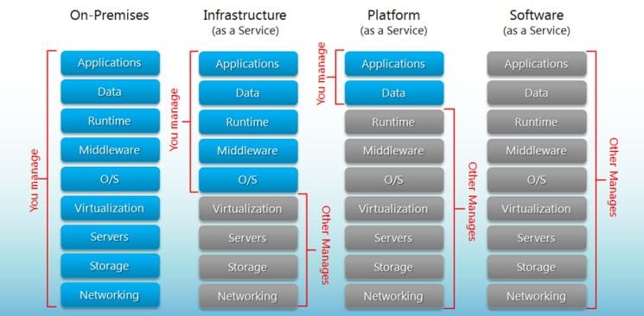

Slide 25
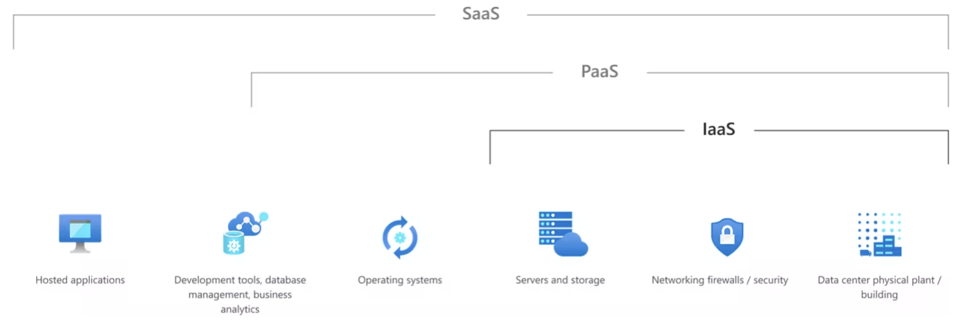

Slide 26
So…Which Cloud?

Slide 27
The "Old" way of thinking about clouds
AWS: Storage and Compute
First to market
Cheap (to start)
Now: expensive(r)
Google: Data, Analytics, and ML/AI
Used its prowess with search and analytics to attract customers
Has always had an ADHD mindset – jumps from one project to the next
Is still a serious player, but stuck in a rut
Azure: Good for lifting and shifting
Many enterprises already have Microsoft implementations
Azure made its bones on allowing companies to move from on-prem to off-prem (or hybrid)
Making big leaps in ML/AI (OpenAI)

Slide 28
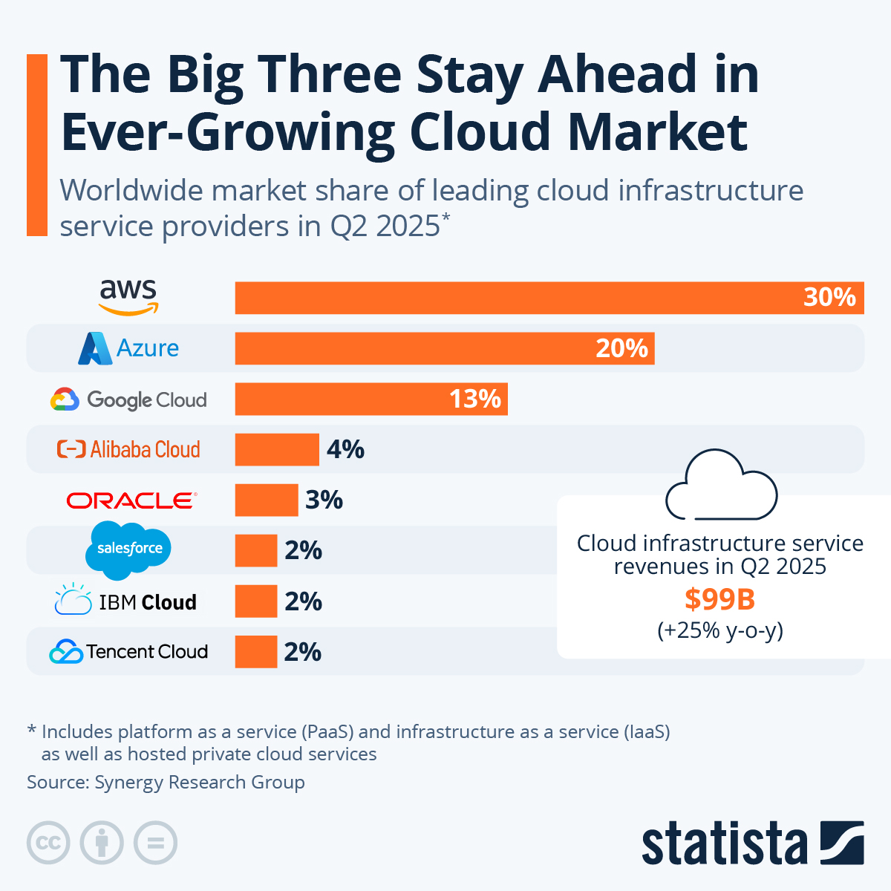

Slide 29
How will you learn?

Slide 30
Activities in the Course
Hands-on labs through AWS Academy
A few hands-on labs during class time (later in the term)
Practice quizzes based on the CLF-C02 exam
Final Project options
Take the CLF-C02 exam
Final project following my instructions

Slide 31
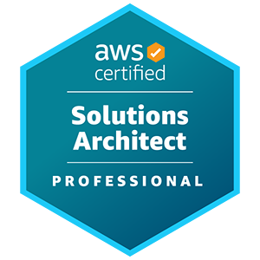
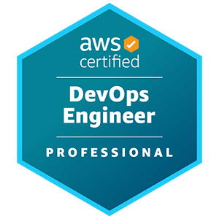
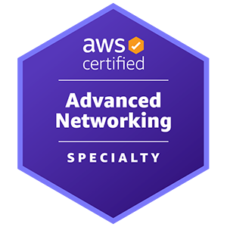
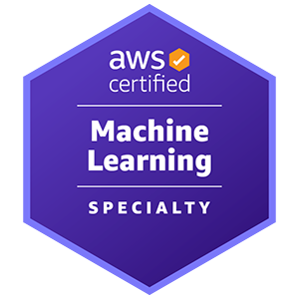
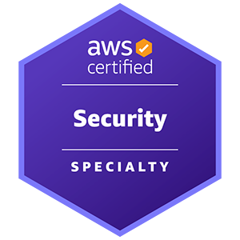
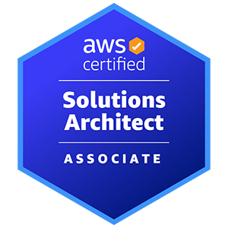
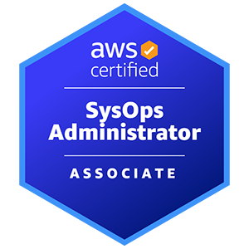
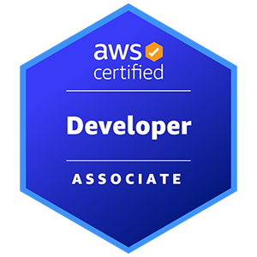
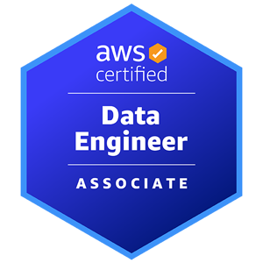

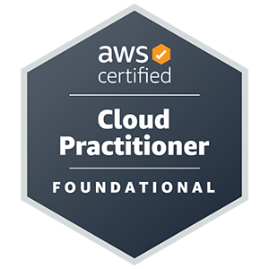
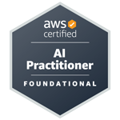
AWS Certification exams
Role-based certifications
Specialty certifications
Professional level
Associate level
Foundational level
Notes:
AWS Certification helps learners build credibility and confidence by validating their cloud expertise with an industry-recognized credential, and it helps organizations identify skilled professionals who can lead cloud initiatives by using AWS.
You must earn a passing score via a proctored exam to earn an AWS Certification. After receiving a passing score, you will receive your certification credentials.
AWS Certification does not publish a list of all services or features that are covered in a certification exam. However, the exam guide for each exam lists the current topic areas and objectives covered in the exam. Exam guides can be found at https://aws.amazon.com/certification/certification-prep/?src=certification-faqs.
You will be required to update your certification (or recertify) every 3 years. View the AWS Certification Recertification page at https://aws.amazon.com/certification/recertification/ for more details.
The information on this slide is current as of November 2024. However, exams are frequently updated and the details regarding which exams are available—and what is tested by each exam—are subject to change.
For the latest AWS certification exam information, go to https://aws.amazon.com/certification/.

Slide 32
AWS Certified Cloud Practitioner exam
Details about the exam—including how to register for it—are at https://aws.amazon.com/certification/certified-cloud-practitioner/
Download and carefully read the AWS Certified Cloud Practitioner Exam Guide at https://d1.awsstatic.com/training-and-certification/Docs - Cloud Practitioner/AWS_Certified_Cloud_Practitioner-Exam_Guide_EN_v1.6.pdf
Download the sample exam questions at https://d1.awsstatic.com/training-and-certification/Docs - Cloud Practitioner/AWS Certified Cloud Practioner_Sample Questions_v1.1_FINAL.PDF
See the recommended path to attain the certification at https://aws.amazon.com/training/path-cloudpractitioner/
AWS Academy Cloud Foundations covers much of the same material found in the Cloud Practitioner Essentials course, but in greater depth.
There is additional free digital training available at https://www.aws.training/.
Notes:
The AWS Certified Cloud Practitioner certification provides individuals in various cloud and technology roles with a way to validate their AWS Cloud knowledge and enhance their professional credibility. This exam covers four domains, including cloud concepts, security, technology, and billing and pricing.
The AWS Certified Cloud Practitioner exam is the only AWS certification exam that is classified as foundational (as shown on the previous slide). It is often the first AWS exam that IT professionals attempt to obtain.
Though this AWS Academy Cloud Foundations course is not listed in the AWS Certified Cloud Practitioner Exam Guide as one of the AWS training options recommended to prepare for the exam, this course does cover many of the same topics that are covered by AWS commercial courses, such as AWS Technical Essentials, AWS Business Essentials, and AWS Cloud Practitioner Essentials. Therefore, the AWS Academy Cloud Foundations course you are taking now is a good way to help prepare yourself to take this exam.
The services included in the AWS Certified Cloud Practitioner exam change as new services are added. At a minimum, you should be able to describe the overall functionality of a broad range of AWS services before taking the exam. For an overview of the AWS services see the Amazon Web Services Cloud Platform section of the Overview of Amazon Web Services whitepaper at https://docs.aws.amazon.com/whitepapers/latest/aws-overview/amazon-web-services-cloud-platform.html.

